Slide 1
Custom Update Centers

Slide 2
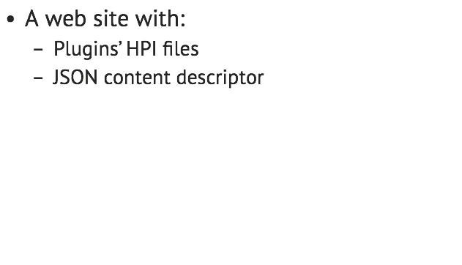
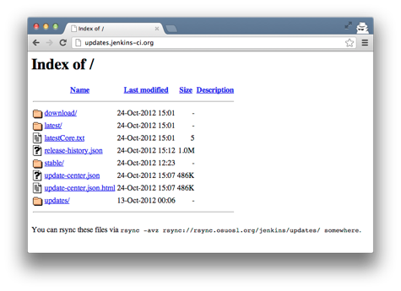
What is a Jenkins Update Center?

Slide 3
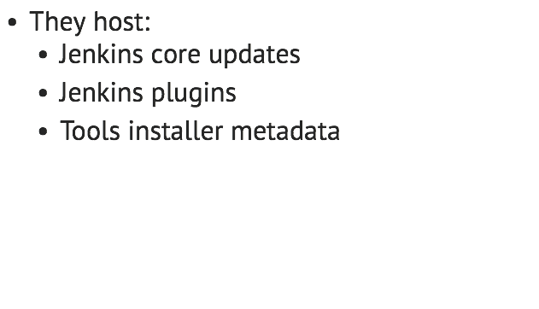
What is a Jenkins Update Center?

Slide 4
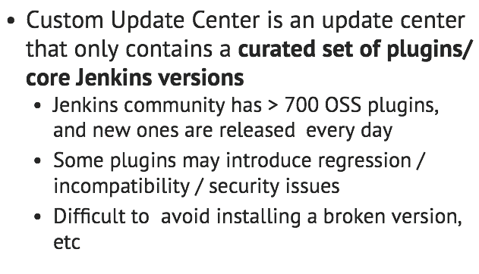
What is a Custom Update Center?

Slide 5
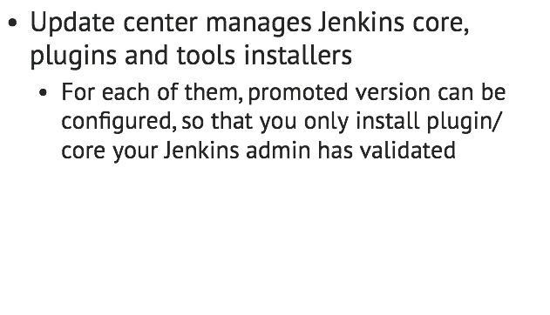
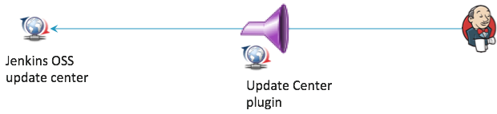
What is a Custom Update Center?

Slide 6
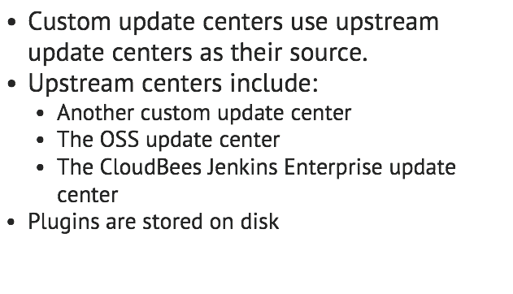
What is a Custom Update Center?

Slide 7
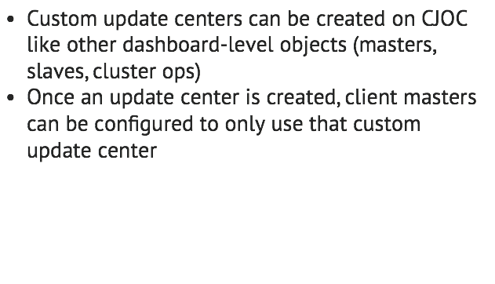
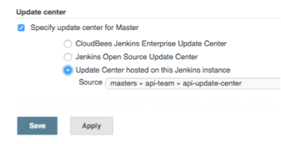
How do I use a Custom Update Center with CJOC?

Slide 8
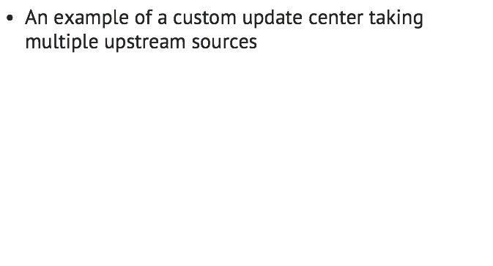
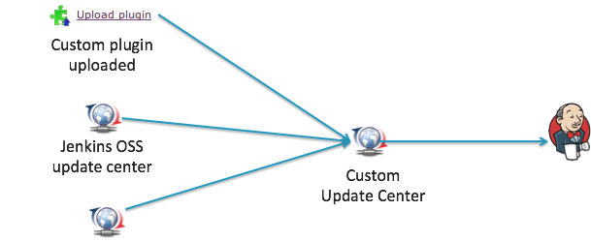

How do I use a Custom Update Center with CJOC?

Slide 9
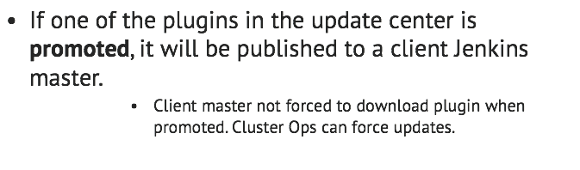
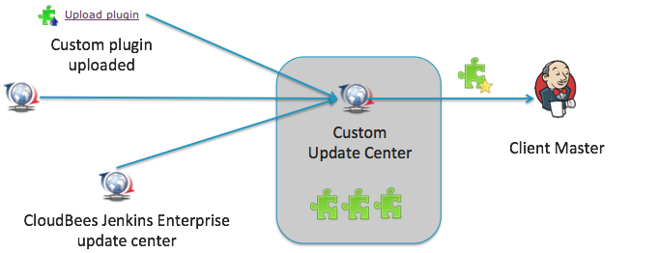
How do I use a Custom Update Center with CJOC?

Slide 10
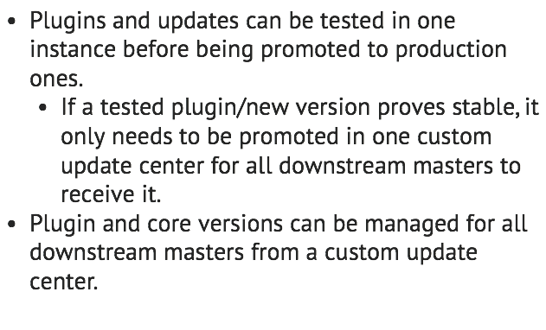
Benefits: manageability

Slide 11
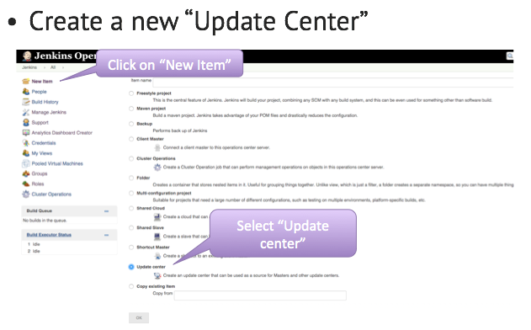
Where do we start?

Slide 12
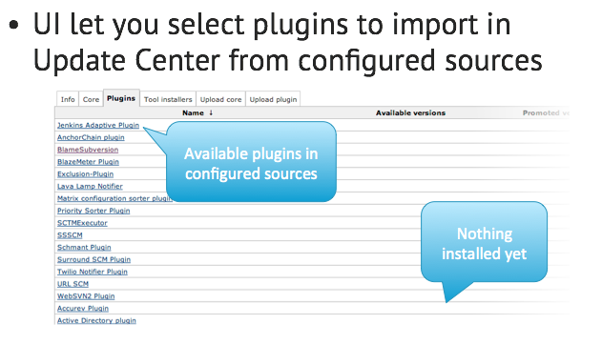
Where do we start?

Slide 13
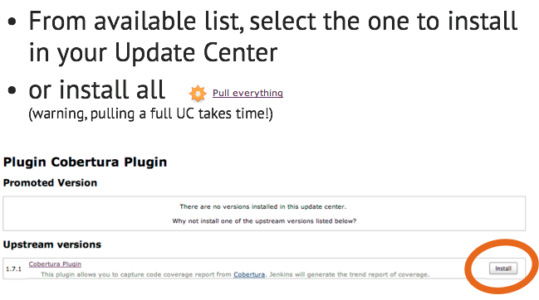
Where do we start?

Slide 14
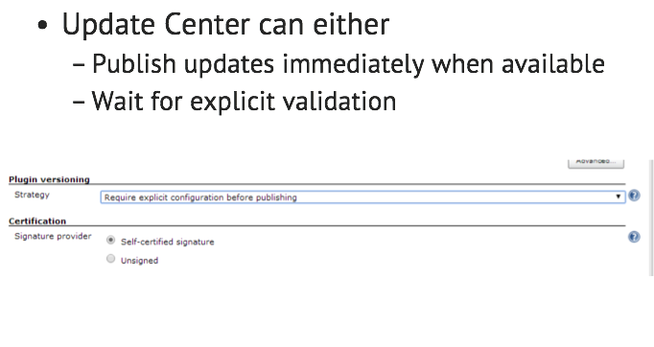
Where do we start?

Slide 15
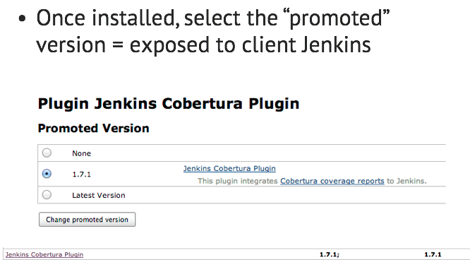
Where do we start?

Slide 16
Lab Exercise:
Setting up a custom update center

